Slide 1

Damien Hogan
Damien Hogan Assignment One HCI Presentation November 2017
Intelligent User Interface
Notes:
HCI (Human Computer Interaction) seeks to provide an understanding of the human user and the computer system, in an effort to make the interactions between the two easier, more efficient and more satisfying .
Interface agents are computer programs that provide personalised assistance to users with their computer-based tasks. Most interface agents achieve personalisation by learning a user's preferences in a given application domain and assisting him according to them.
Task-orientated AI can be found at work in a many places, from the Netflix recommendation engine to the natural language processing (NLP) used in Amazon’s Alexa-powered Echo. Artificial intelligence is a broad a term that has been used by companies who want to make their software algorithms sound smarter than they really are.
The Turing Archive for the History of Computing defines artificial intelligence (AI) as “the science of making computers do things that require intelligence when done by humans.”
We learn by watching others engage in different behaviours involving attention, retention, reproduction and reinforcement. For AI reproducing behaviour is a limiting factor as robots do not have the physical capability to reproduce all of our actions even though they can observe them.
Cognition is the process of receiving, processing, storing and using information, it is the mental processes underlying our ability to perceive the world, enabling us to remember, discuss and learn from our experiences. It includes functions such as perception, memory, language and thought.
In Biederman's Recognition-by-components theory, using our knowledge of geons, which are the simple 2D or 3D forms such as cylinders, bricks, wedges, cones, circles and rectangles corresponding to the simple parts of an object these basic shapes to recognise what an object is and also make inferences about what it does or what it is capable of doing. For AI it is more complex as it could not always decipher the context of an object, person or an animal. In the past ten years there has been a huge leap forward as AI provides the processing power behind everything from facial recognition software to the computer vision systems in driverless cars and even the spam filters in our email.
AI has the advantage over humans in that it can focus its attention on many tasks enabling better outputs or results not previously thought of, whereas we must be be selective in terms of the mass of competing stimuli which limits our ability to keep track of all events. We can see this in the Volvo advertisement which depicts a distracted driver and a car that can recognise a child crossing the road and stopping the vehicle using its own initiative.
AI and cognitive computing systems are based on the ability of machines to sense, reason, act and adapt based on learned experience and will be able to relieve us of a wide range of tasks, such as driving, mining and many more labour intensive tasks.
Voice recognition software listens to what the user says, interprets the sounds, and displays the information on the screen. All the big Tech companies seem convinced that talking to an AI will soon become the dominant way we interact with our computers. Among the better known Virtual personal assistants Amazon has Alexa, Apple's Siri, Microsoft's Cortana, and Google has updated their Google Assistant.
A user can either speak into their tablet, phone or pc for these interactions or use one of the many smart speakers which can be positioned around our homes, offices or in our car to relay commands to the AI of choice. These speakers connect to the users AI of choice and is completely capable of controlling your smart home, so you can simply connect all your smart home devices to the speaker, and control them with your voice.
The most basic advantages of AI are cost reduction, speed, flexibility, reliability, durability and duplication. An AI system can perform a task that is handled by several workers thus it cuts on wage costs, is capable of providing an immediate response and in addition has no time limitation nor has it moods like humans. They are designed to last for long periods of time and can be used over and over again.
They can be expensive to buy, operate and maintain due to the specificity of each one's capabilities, they cannot be used in isolation without the presence of human beings, they can only handle specific tasks that they are designed for e.g. an AI designed for driving a car cannot be expected to be an expert in the medicine field.
In conclusion, artificial intelligence systems have been useful tools in solving complex problems that are seen to be beyond the level of human thinking. Although the characteristics of these systems are drawn from human intelligence, they exhibit more intelligence than the human beings themselves. This is just the beginning in computer revolution and more improvements are likely to be seen in the near future.

Slide 2
What is an Intelligent User Interface
An intelligent user interface (Intelligent UI, IUI, or sometimes InterfaceAgent) is a user interface (UI) that involves some aspect of artificial intelligence (AI or computational intelligence).
Notes:
INTELLIGENT USER INTERFACE
An intelligent user interface involves some aspect of artificial or computational intelligence. Human Computer Interaction seeks to provide an understanding of the human user and the computer system, in an effort to make the interactions between the two easier, more efficient and more satisfying. Most interface agents achieve personalisation by learning a user's preferences in a given application domain and assisting them according to those preferences (Höök, 2000).
The Turing Archive for the History of Computing (alanturing.net, 2017) defines AI as “the science of making computers do things that require intelligence when done by humans.”

Slide 3
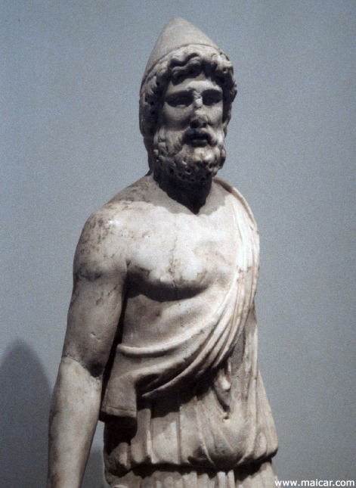
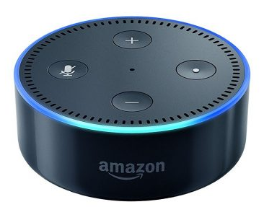
Artificial Intelligence in history
Ancient Greece there were stories of Robotic Humans. Such as with Hephaestus who was the god of the blacksmiths. He discovered ways of working iron, copper, gold and silver.
Notes:
Artificial Intelligence is not a new idea. It can be seen right through from ancient myths and history right up to modern day.
Myths that Hephaestus, the blacksmith manufactured mechanical servants, and the bronze man Talos incorporate the idea of intelligent robots. These were only stories of myth and legend, yet the ancients had the comprehension or the desire to dream up such inventions.
In the 13th century mechanical talking heads (magical) were said to have been created, reputedly among the owners was English philosopher and Franciscan friar Roger Bacon who placed considerable emphasis on the study of nature through empiricism, which is a theory that states that knowledge comes only or primarily from sensory experience.

Slide 4
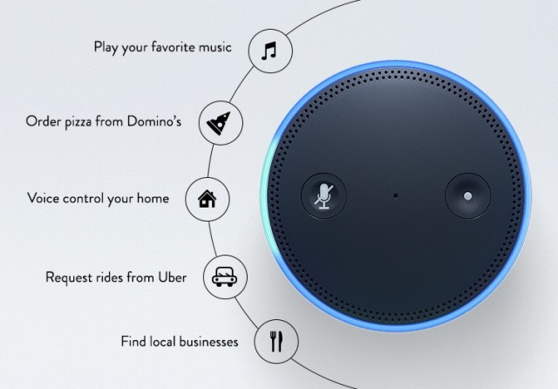
Voice-controlled devices
Notes:
Task-orientated AI can be found at work in many places, from the Netflix recommendation engine to the natural language processing used in Amazon’s Echo. AI is a broad a term that has been used by companies who want to make their software programmes sound smarter than they really are.
Voice recognition software listens to what the user says, interprets the sounds, and displays the information on the screen. Among the better known Virtual personal assistants Amazon’s Alexa, Apple's Siri, Microsoft's Cortana, and Google Assistant.
A user can either speak into their tablet, phone or pc for these interactions or use one of the many smart speakers which can be positioned around our homes, offices or in our car to relay commands to the AI of choice. These speakers connect to the users AI of choice and is completely capable of controlling your smart home, so you can simply connect all your smart home devices to the speaker, and control them with your voice.
Amazon Echo Dot is a hands-free, voice-controlled device that uses Alexa to play music, control smart home devices, provide information, read the news, set alarms and more
Connects to speakers or headphones through Bluetooth or 3.5 mm stereo cable to play music from Amazon Music, Spotify and TuneIn. Play music simultaneously across multiple Echo devices and speakers connected via cable with multi-room music (Available for Amazon Music and TuneIn. Bluetooth not supported)
Controls lights, switches, thermostats and more with compatible connected devices from WeMo, Philips Hue, Hive, Netatmo, Nest, tado° and others
Hears you from across the room with 7 microphones for far-field hands-free voice control, even in noisy environments or while playing music
Includes a built-in speaker so it can work on its own as a smart alarm clock in the bedroom, an assistant in the kitchen, or anywhere you might want a voice-controlled device
Always getting smarter - Alexa updates through the cloud automatically and is continually learning, adding new features and skills

Slide 5
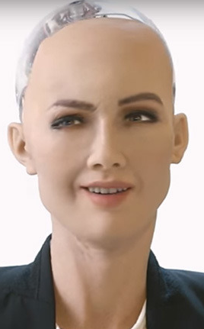
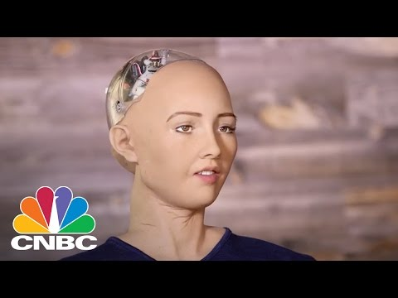
Sophia first-ever robot citizen
Notes:
Sophia first-ever robot citizen
Robotics is finally reaching the mainstream and androids - humanlike robots - are everywhere and experts believe humanlike robots are the key to smoothing communication between humans and computers, and realizing a dream of compassionate robots that help invent the future of life.
One such robot has been created by David Hanson, the founder of Hong Kong-based Hanson Robotics, who is known for creating robots that look and act like humans.
She has cameras and AI software that allow her to 'make eye contact' and recognise people.
This one of its kind robot was designed to make over 50 facial expressions as users ask about the weather, traffic and basic trivia. She also has voice recognition capabilities and can become smarter by talking with people.
Sophia has been designed to learn and adapt to human behavior and work with humans, and has been interviewed around the world. In October 2017, she became a Saudi Arabian citizen, the first robot to receive citizenship of a country.The irony of a nation infamous for denying basic rights to its female citizens!
But Sophia and her future robot will have the ability to help with elderly care homes or help keep older and infirm people at home and assist visitors at parks and events. Sophia was quoted as saying “she wanted to use her artificial intelligence to help humans live a better life, and that I will do much best to make the world a better place”. Not perfect English but close enough to understand - she (it) is still learning. While researching I saw an interview with Piers Morgan who called her a freak and the other presenter almost took offence as she had already humanised the robot in some way.

Slide 6
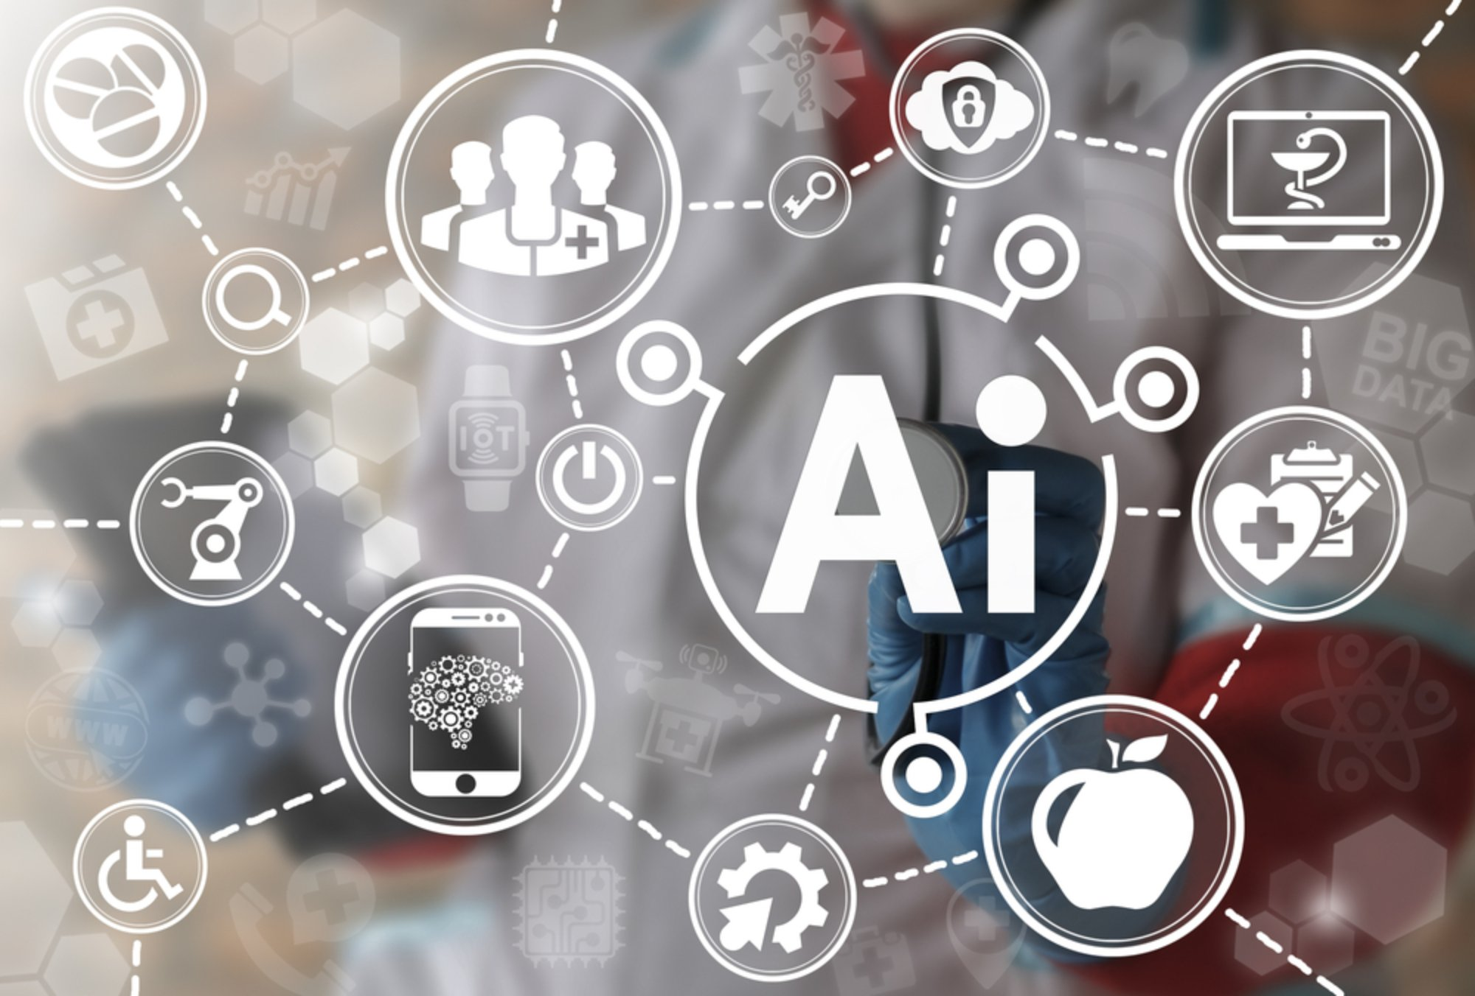
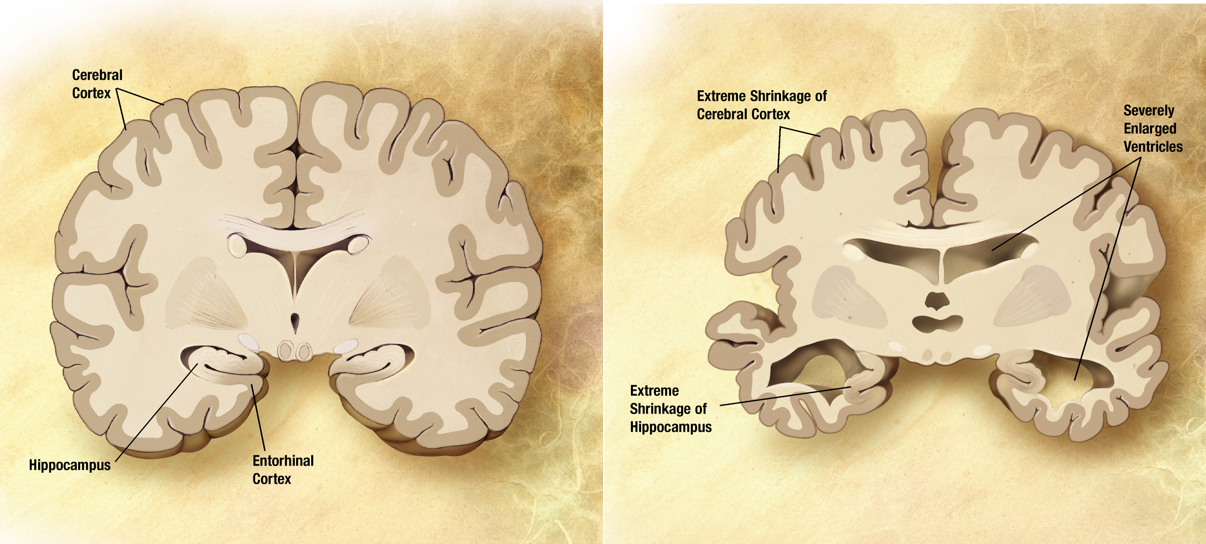
Artificial Intelligence in Medicine
Notes:
Artificial Intelligence in Medicine
Artificial intelligence algorithms are not only making our cars safer and shopping easier, but increasingly diagnose patients and help make the best decisions when caring for them.
These findings have direct implications for the design of future trials. We have known bits and pieces of this information – that there are dozens of genes that put people at risk or that certain brain changes put people at risk – but an unbiased tool such as an AI algorithm could put all of these pieces of information together, painting a picture that scientists might not have otherwise seen.
AI identified two groups of interest: those whose cogn­­­ition declined very rapidly and were at highest risk for Alzheimer’s; and those who saw little or no decline in their symptoms. A third group remained unclustered.
Brain scans of ‘rapid decliners’ showed twice the rate of atrophy as those for whom the disease was slow moving. Rapid decliners also progressed from mild cognitive impairment to dementia at five times the rate of those with a slow-moving disease. The full findings were published in July in Scientific Reports.
Looking at common traits of rapid decliners, it’s possible that in the future such algorithms could help doctors identify those most at risk from Alzheimer’s years before diagnosis.
Scientists could much more precisely test the impact of investigational drugs if we could better identify and group those with similar brain changes and cognitive impairment. To do this, we applied a multilayer clustering algorithm to analyse dozens of data points from a US study called the Alzheimer’s Disease Neuroimaging Initiative, including cognition tests, brain scans and spinal fluid biomarkers. The samples were taken from 562 people with mild cognitive impairment followed for up to five years.
People with problems are considered as just (statistical) numbers and symptoms in crowded waiting rooms, while doctors have only a few minutes for each patient on average and have to go on with their packed schedule as soon as possible. Thus, it is not surprising that patients experiencing grumpy doctors try to turn to empathy coming from someplace else, and digital technology tries to tap into that existing gap.
And why do medical professionals have so little time for patients? They are suffering from the burden of administration, monotonous tasks and the lack of colleagues. Doctor shortages are global phenomena. The World Health Organization (WHO) estimates that there is a worldwide shortage of around 4.3 million physicians, nurses, and allied health workers. At the same time, the need for healthcare services is rising: illnesses are becoming easier to catch, civilizational diseases such as diabetes and obesity is on the rise while aging societies need more and more care. So medical virtual assistants, healthcare chatbots or humanoid robots with a pinch of empathy seize the moment and claim their places as new helpers of medical professionals.

Slide 7


Fraud Detection
First Person Games
Have you ever gotten an email or a letter asking you if you made a specific purchase on your credit card?
First-person shooters like Call of Duty also make significant use of AI
Notes:
Xbox games
First-person shooters like Call of Duty also make significant use of AI, with enemies that can analyze their environments to find objects or actions that might be beneficial to their survival; they’ll take cover, investigate sounds, use flanking maneuvers, and communicate with other AIs to increase their chances of victory. As far as AI goes, video games are somewhat simplistic, but because of the industry’s huge market, a great deal of effort and money are invested every year in perfecting this type of AI.
Fraud Dretection
Many banks send these types of communications if they think there’s a chance that fraud may have been committed on your account, and want to make sure that you approve the purchase before sending money over to another company.
Artificial intelligence is often the technology deployed to monitor for this type of fraud
In many cases, computers are given a very large sample of fraudulent and non-fraudulent purchases and asked to learn to look for signs that a transaction falls into one category or another. After enough training, the system will be able to spot a fraudulent transaction based on the signs and indications that it learned through the training exercise.

Slide 8

62.9%
World Population have Smart Phones
Notes:
Almost 70% of the worlds populations has some sort of smart phone - Smartphones now being built with AI technology will open open the market.
If virtual assistants have been the breakthrough technology in this year’s smartphone software, then the AI processor is surely the equivalent on the hardware side.
Apple has taken to calling its latest SoC the A11 Bionic on account of its new AI “Neural Engine”. Huawei’s latest Kirin 970 boasts a dedicated Neural Processing Unit (NPU) and is billing its upcoming Mate 10 as a “real AI phone“. Samsung’s next Exynos SoC is rumored to feature a dedicated AI chip too.
Companies would love us to believe that they’ve developed a chip smart enough to think on its own or one that can imitate the human brain, but even today’s cutting edge lab projects aren’t that close. In a commercial smartphone, the idea is simply fanciful. The reality is a little more boring. These new processor designs are simply making software tasks such as machine learning more efficient.
There’s an important difference between artificial intelligence and machine learning that’s worth distinguishing. AI is a very broad concept used to describe machines that can “think like humans” or that have some form of artificial brain with capabilities that closely resemble our own.
Machine learning is not unrelated, but only encapsulates computer programs that are designed to process data and make decisions based on the results, and even learn from results to inform future decisions.

Slide 9

A Strong argument for Artificial Intelligence
Notes:
We learn by watching others engage in different behaviours involving attention, retention, reproduction and reinforcement (Holland, 1991). For AI reproducing behaviour is a limiting factor as it does not have the physical capability to reproduce all our actions even though they can observe them. In 1966 Sternberg likened our information-processing approach to that of computers but did not add that along with stimuli, we require cognition (Roznowski, 1993). Cognition is the process of receiving, processing, storing and using information, it is the mental processes underlying our ability to perceive the world, enabling us to remember, discuss and learn from our experiences. It includes functions such as perception, memory, language and thought. This is difficult for AI to emulate fully but its advantage is that it can focus its attention on many tasks whereas we must be selective in terms of the sheer mass of stimuli which limits our ability to keep track of all events. We can see this in the Volvo advertisement which depicts a distracted driver in a car which can recognise a child crossing the road and is able to stop without harming the child. AI and cognitive computing systems are based on the ability of machines to sense, reason, act and adapt based on learned experience and will be able to relieve us of many labour intensive tasks.
The most basic advantages of AI are cost reduction, speed, flexibility, reliability, durability and duplication. An AI system can perform the tasks of several workers thus cutting wage costs, can respond immediately in addition to having no time limitation. It has no moods like humans, are designed to last for extended periods of time and can be used repeatedly (Love, 2017).
They can be expensive to buy, operate and maintain due to the specificity of each one's capabilities. They cannot be used in isolation without the presence of human beings. They can only handle specific tasks that they are designed for e.g. an AI designed for driving a car cannot be expected to be an expert in the medicine field.
In conclusion, artificial intelligence systems have been useful tools in solving complex problems that are seen to be beyond the level of human thinking. Although the characteristics of these systems are drawn from human intelligence, they can exhibit more intelligence than the human beings themselves. We are at the start of the AI revolution and more improvements are likely to be seen soon.

